Slide 1
FNF Knowledge Hub
Akarsh M
Ashirwad
Sumant Nidoni
Supritha Chand
Swaroop K R

Slide 2
Agenda
Introduction
Key Objectives
Roles and Responsibility
Core Use Cases
Flowchart
Team Roles and Module Division
Conclusion

Slide 3
Introduction
FNF Knowledge Base is an internal corporate platform that enables employees to share knowledge, raise issues, and collaborate effectively.
It acts as a centralized communication and knowledge hub for posts, discussions, and feedback across departments.
Features role-based access control (RBAC) with limited guest access, full employee participation.
Enhances collaboration, preserves knowledge, and boosts productivity; Supports attachments like images and code snippets.

Slide 4
Key Objectives
Promote knowledge exchange within the organization.
Ensure managerial oversight and proper content moderation.
Provide real-time collaboration and feedback via SignalR.
Enable role-based permissions for Employees, Managers, and Admins.
Enhance productivity and reduce communication silos.

Slide 5

Roles and Responsibilities
Employees : Create posts, comment, vote, and share knowledge.
Manager : Review and commit employee posts, provide feedback.
Admin : Manage departments, users, and system configurations.
Departments (HR / IT / Compliance Team) : Consume knowledge posts and track issue resolutions.

Slide 6
Core Use Cases
1. Post Creation & Management : Employees create posts about issues, queries, or knowledge.
2. Comment System : Users discuss and provide clarifications.
3. Voting Mechanism : Upvote/Downvote for feedback and relevance.
4. Commit Feature (Manager Action) : Managers mark resolution or acknowledgment.
5. Repost Feature : Users can share important posts across departments.
6. Real-time Notifications : SignalR broadcasts live updates for commits done by Manager.

Slide 7
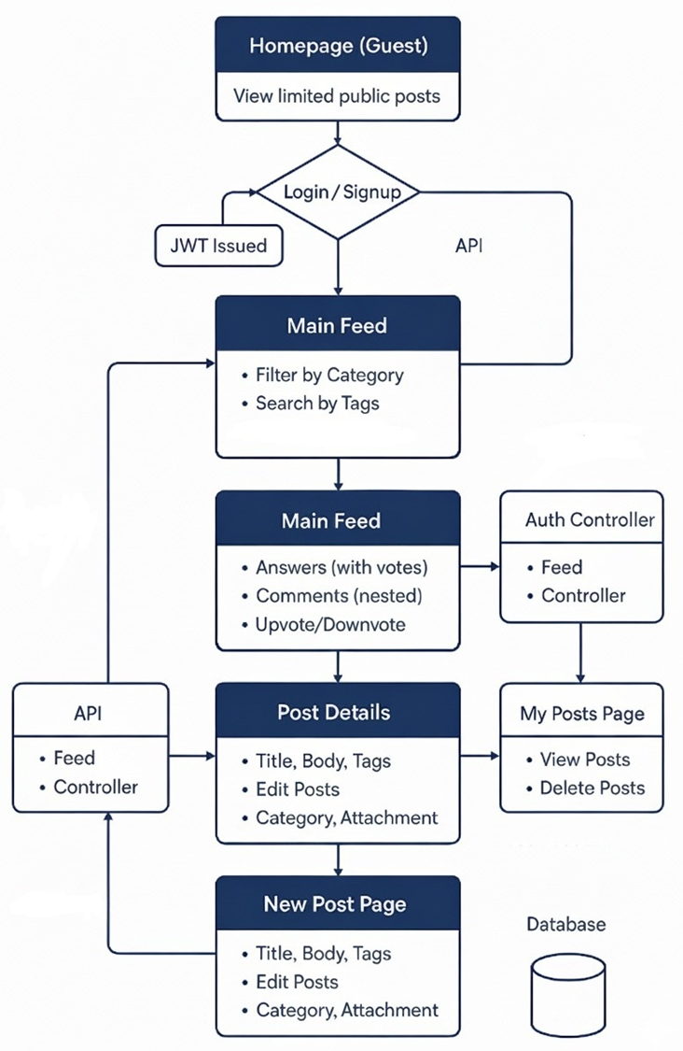
Flowchart:
7

Slide 8
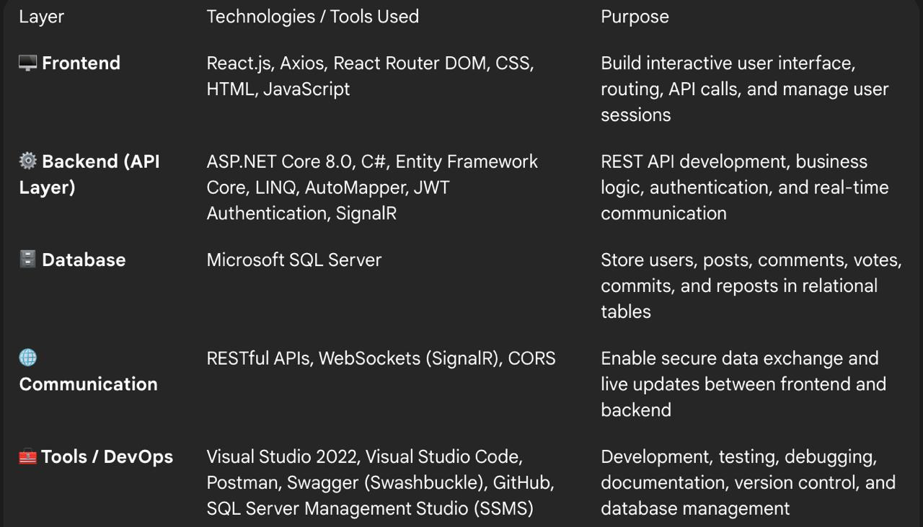
Tech Stack
8

Slide 9

Team Role and Module Division
9

Slide 10
Authentication & User Management -By Ashirwad
Designing smooth transitions between guest access, signup, and authenticated sessions.
Implementing role-based restrictions (guest vs. manager vs. employee).
Implement secure JWT-based authentication within the local storage
Work Undertaken (Frontend and Backend) :
Auth Functionality Setup– Entity, Dtos and Controllers
Services : JWT generation in AuthService.cs and UserService.cs forGetUserById(), UpdateUser()
Login.jsx, Register.jsx, Profile.jsx
Utility: utils/auth.js → saveAuth(), logout(), getRole()
10

Slide 11
Authentication & User Management -By Ashirwad
Challenges Faced :
Implementing smooth transitions between guest, signup, and authenticated states while preserving user context.
Auth token saving and retrieving the attributes within the frontend when needed.
Issues Faced :
Token not being saved properly or it has passed its expiration time
Auth state may become inconsistent, causing unexpected redirects or access issues during transitions.
11

Slide 12
Posts & Feed Management By Swaroop and Sumant
Developed CRUD Functionalities for Posts with Tagging , Department linkage and previews.
Commit System for Managers to commit on posts to confirm validation/resolution.
Repost Module allows users to share posts with others; tracks repost history.
Work Undertaken (Frontend and Backend) :
Post and Commits Setup - Entity, Dtos ,Controllers and Services
PostService.cs → handles logic for post creation, tagging, dept mapping
MappingProfile.cs for Post ↔ DTO mapping
Feed.jsx, PostDetails.jsx, PostCreate.jsx ,PostCard.jsx etc..
12

Slide 13
Posts & Feed Management By Swaroop and Sumant
Challenges Faced:
Implementing a rich-text editor with syntax highlighting.
Ensuring fast rendering with many posts in feed using Pagination Helper
Attachments File upload and display support using FormData API.
13

Slide 14
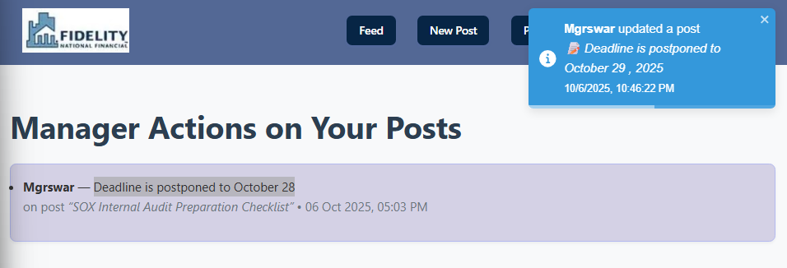
Notification System and User profile Management -By Supritha
SignalR , a open source ASP.NET library is used to handle real-time updates for notifying commits, and comments
Developed Profile Edit Functionalities for updating the User Profile
Frontend – EditProfile.jsx for Updating profile and styling
Backend – UserController.cs, AuthServices.cs and setup NotificationHub for SignalR
Designed and styled Home Page and Feed Page

Slide 15
Comments and Votes -By Akarsh
• Toggle comments show/hide and lazy fetch (hierarchical=true); Post top-level comments and replies (parentCommentId supported)
Supports voting on posts and comments (separate PostId/CommentId fields).
• Toggle behavior: clicking same vote removes it; clicking opposite changes vote type.
Upvote / downvote with per-user vote tracking; Lazy-load replies, preserve cached replies, reply count shown
Work Undertaken (Frontend and Backend) :
• Votes and Comments – Entity, DTOs , Controllers and Services
VoteService.VoteAsync: finds existing vote by (user, postId, commentId).
• Frontend (PostCard / CommentItem): calls vote endpoints and refreshes UI (counts & userVote).

Slide 16
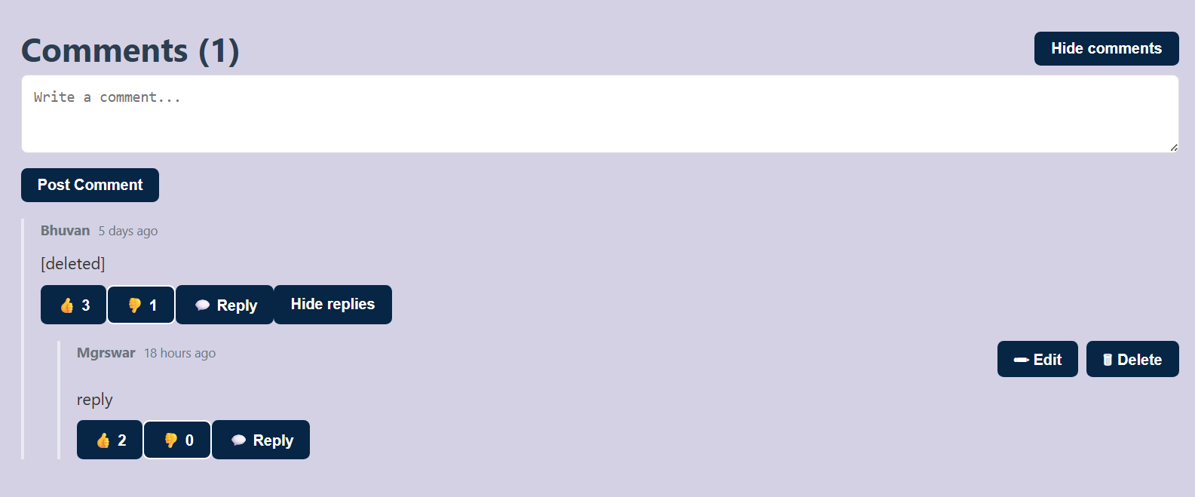
Comments and Votes
Challenges:
Nested System for Comments ( i.e, Parent and child comments)
Allowing privileges to edit and delete Comments for Owner and Manager (with commit message)
Designing scalable voting logic with history tracking and votes counting api calls
Preventing duplicate votes by the same user. Handling vote reversal(upvote → downvote).

Slide 17
Task | Backend | Frontend
Authentication & User Management | AuthController Authservice | Components: Login/Signup, GuestPage Services: AuthService
Posts & Editing | PostsController PostsService | Components: Feed, EditPost, PostEditor, MyPosts Services: PostsService
Comments | CommentsController CommentsService | Components: CommentSection, Commits Services: CommentsService
Reposts & Votes | RepostsController VotesController VoteService | Services: RepostService
Tags & SignalR | TagsController TagsService SignalR Hub for real-time comments | Components: Tags, Navbar Services: TagsService

Slide 18
Conclusion:
Built a secure Q&A hub with role-based access for guests, employees, and managers.
Enabled posts, comments, votes, tags, and reposts for collaboration.
Added real-time updates with SignalR to enhance engagement.
Improved teamwork and strengthened full-stack skills in .NET & React.
18

Slide 19
Thank you

